Slide 1
Home Automation
By:
Amaan Ranapurwala
Aniruddha kate
Dewam Katole
Ritvik Nimje
From :
Shri Datta Meghe Polytechnic College

Slide 2
Project Introduction
Today in the headway of Automation innovation, life is getting simpler and less demanding in all spheres. Home automation is a modern technology that modifies your home to perform different sets of tasks automatically. Today Automatic frameworks are being favored over manual frameworks. The first and most obvious advantage of Smart Homes is comfort and convenience, as more gadgets can deal with more operations (lighting, temperature, and so on) which in turn frees up the resident to perform other tasks. Home automation is an appealing context for the Internet of Things (IoT), by connecting the IP gateway directly to the Internet or through a home/residential gateway; this system can be managed remotely using a PC, Smart phone, Tablet or other devices.

Slide 3
Objective of the Project
We can turn on/off lights and fans from anywhere in the world.
The AC/Cooler can automatically turn itself on/off according to temperature we have set.
When the natural lights gets low , the sensor will automatically detect the change in light and will turn on light appliance.

Slide 4
Flow Chart & Circuit Diagram

Slide 5
Node MCU
The Node MCU (Node Micro Controller Unit) is open source software and hardware development environment that is built around a very inexpensive System-on-a-Chip (SoC) called the ESP8266. The ESP8266 designed and manufactured by Espress if Systems, contains all crucial elements of the modern computer: CPU, RAM, networking (Wi-Fi), and even a modern operating system and SDK.

Slide 6
Relay
A relay is an electrically operated switch. It consists of a set of input terminals for a single or multiple control signals, and a set of operating contact terminals. The switch may have any number of contacts in multiple contact forms, such as make contacts, break contacts, or combinations thereof.

Slide 7
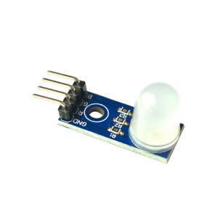
RGB LED
RGB LED means red, blue and green LEDs. RGB LED products combine these three colors to produce over 16 million hues of light. Note that not all colors are possible. Some colors are “outside” the triangle formed by the RGB LEDs. Also, pigment colors such as brown or pink are difficult, or impossible, to achieve.

Slide 8
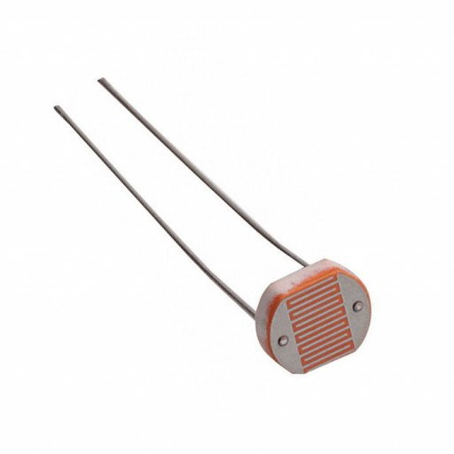
LDR Sensor
The LDR Sensor Module is used to detect the presence of light / measuring the intensity of light. The output of the module goes high in the presence of light and it becomes low in the absence of light. The sensitivity of the signal detection can be adjusted using potentiometer.

Slide 9
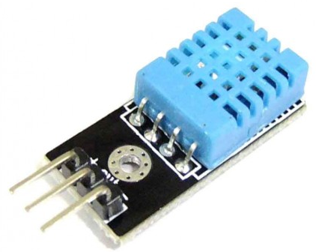
DHT 11
DHT11 is a Humidity and Temperature Sensor, which generates calibrated digital output. DHT11 can be interface with any microcontroller like Arduino, Raspberry Pi, etc. and get instantaneous results. DHT11 is a low-cost humidity and temperature sensor which provides high reliability and long-term stability.

Slide 10


Blynk App & Arduino Software
Blynk is a Platform with iOS and Android apps to control Arduino, Raspberry Pi and the likes over the Internet. It’s a digital dashboard where we can build a graphic interface for our project by simply dragging and dropping widgets. Blynk is not tied to some specific board or shield. Instead, it's supporting hardware of our choice. Whether our Arduino or Raspberry Pi is linked to the Internet over Wi-Fi, Ethernet or this new ESP8266 chip, Blynk will get you online and ready for the Internet of Your Things.
Arduino is an open-source platform used for building electronics projects consists of both a physical programmable circuit board (often referred to as a microcontroller) and a piece of software, or IDE (Integrated Development Environment) that runs on your computer, used to write and upload computer code to the physical board.

Slide 11
Working of the Project
To achieve the home control using smart phone, initially the mobile unit should be connected to any network and the Wi-Fi module ESP8266 which is on Node MCU should be connected to local network. By touching the specified location of widgets in the blynk app, this blynk app sends ON/OFF commands to ESP8266 on Node MCU via Blynk server. Then the relays connected to Node MCU perform switching operation corresponding to the input. So that the loads connected to relays will be switched ON/OFF. Similarly, we can also control our home appliances using manual switches. This can be obtained by connecting the relays outputs to manual switches and manual switches to the AC loads. Whenever the relay corresponding to manual ON or OFF is switched ON then the AC loads corresponding to that switches will perform switching operation.

Slide 12
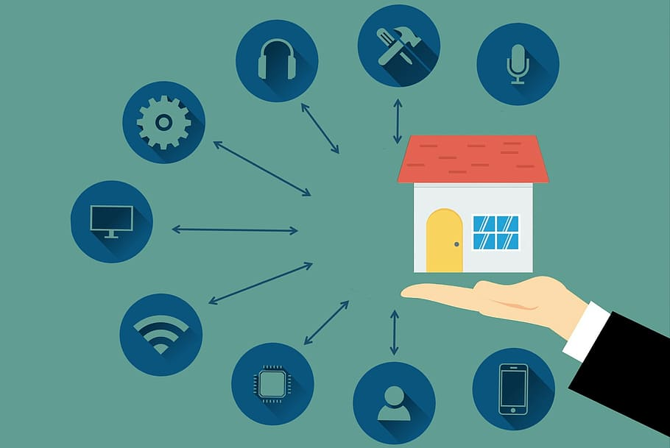
Scope of the Project
In real time web based home automation system this project can be extended in future to ensure the high security, the motion and vibration can be monitored through online via HD spy camera. With this, the system can be incorporated in a whole building of any institution or residential building and can monitor from anywhere. This way, advantages of home automation can be more availed.

Slide 13
Applications of The project
The inefficiency of operation of conventional wall switches can be overwhelmed using various home automation systems (without using conventional switching methods).
The loss of power can be reduced and manpower required for home automation is very less compared to conventional methods.
The IR, RF, android application, Arduino, Bluetooth, DTMF, etc., based home automation systems can be more efficient, provides ease of operation.
Provides safety from electrical power short circuits while using conventional wall switches to operate loads.
Home automation system with automated door locking and security cameras facilitates more security.
By using a home automation system, we can save a lot of time to operate home appliances from anywhere

Slide 14
Thankyou

